Slide 1

Stock Management System
Group Members:
COHNDSE23.2F-006
COHNDSE23.2F-028
COHNDSE23.2F-053
COHNDSE23.2F-054
COHNDSE23.2F-069

Slide 2

Introduction
A Stock Management System is essential for businesses to manage inventory effectively. This project includes user role management, authentication, and a user-friendly interface.
Objectives:
- Streamline stock tracking and management.
- Ensure secure user access based on roles.

Slide 3

Signup Functionality
1. Input Validation:
- Username must be unique.
- Password: Min 8 characters, at least one uppercase, one number, one special character.
- Telephone: Valid format (e.g., +123456789).
- Name: Valid characters only.
2. Password Confirmation: Verify password matches.
3. Hash Passwords: Use `password_hash()` for security.
4. CAPTCHA: Implement to prevent automated signups.
5. Security Questions: Provide questions for added authentication.

Slide 4
Login Functionality
1. User Verification: Check username and password using `password_verify()`.
2. Security Measures: Implement CAPTCHA for brute-force attack prevention.
3. Session Management: Start session on successful login to maintain user state.

Slide 5
Authentication
Identify the user by confirming the answer to the security question provided during signup.
Flow: If the answer is correct, grant access; otherwise, prompt again or lock the account after failed attempts.

Slide 6
Authorization
Role-Based Access Control:
1. Admin Role:
- Add, update, delete stock items.
- Manage user accounts and roles.
- Access detailed reports.
2. Stockkeeper Role:
- View stock levels and manage orders.
- Update stock quantities.
- Monitor expiration dates.
Dashboard Differences: Screenshots highlighting different functionalities per role.

Slide 7
Security Measures
1. Prevent SQL Injection: Use prepared statements.
2. Validate User Inputs: Sanitize and validate inputs.
3. Data Encryption: Securely store sensitive information.
4. HTTPS Protocol: Use HTTPS to secure data in transit.

Slide 8
Conclusion
The Stock Management System provides an efficient way to manage inventory while ensuring user security and role-based access.
Future Enhancements: Possible integrations with accounting systems and analytics for stock predictions.

Slide 9

Technical Stack
Technologies Used:
- PHP
- MySQL
- HTML/CSS
Development Tools:
- XAMPP / WAMP
- Visual Studio Code

Slide 10
Challenges Faced
1. SQL Injection Prevention: Ensuring secure database interactions.
2. User Experience: Designing intuitive interfaces for both roles.
3. Implementing CAPTCHA: Integrating security measures effectively.

Slide 11
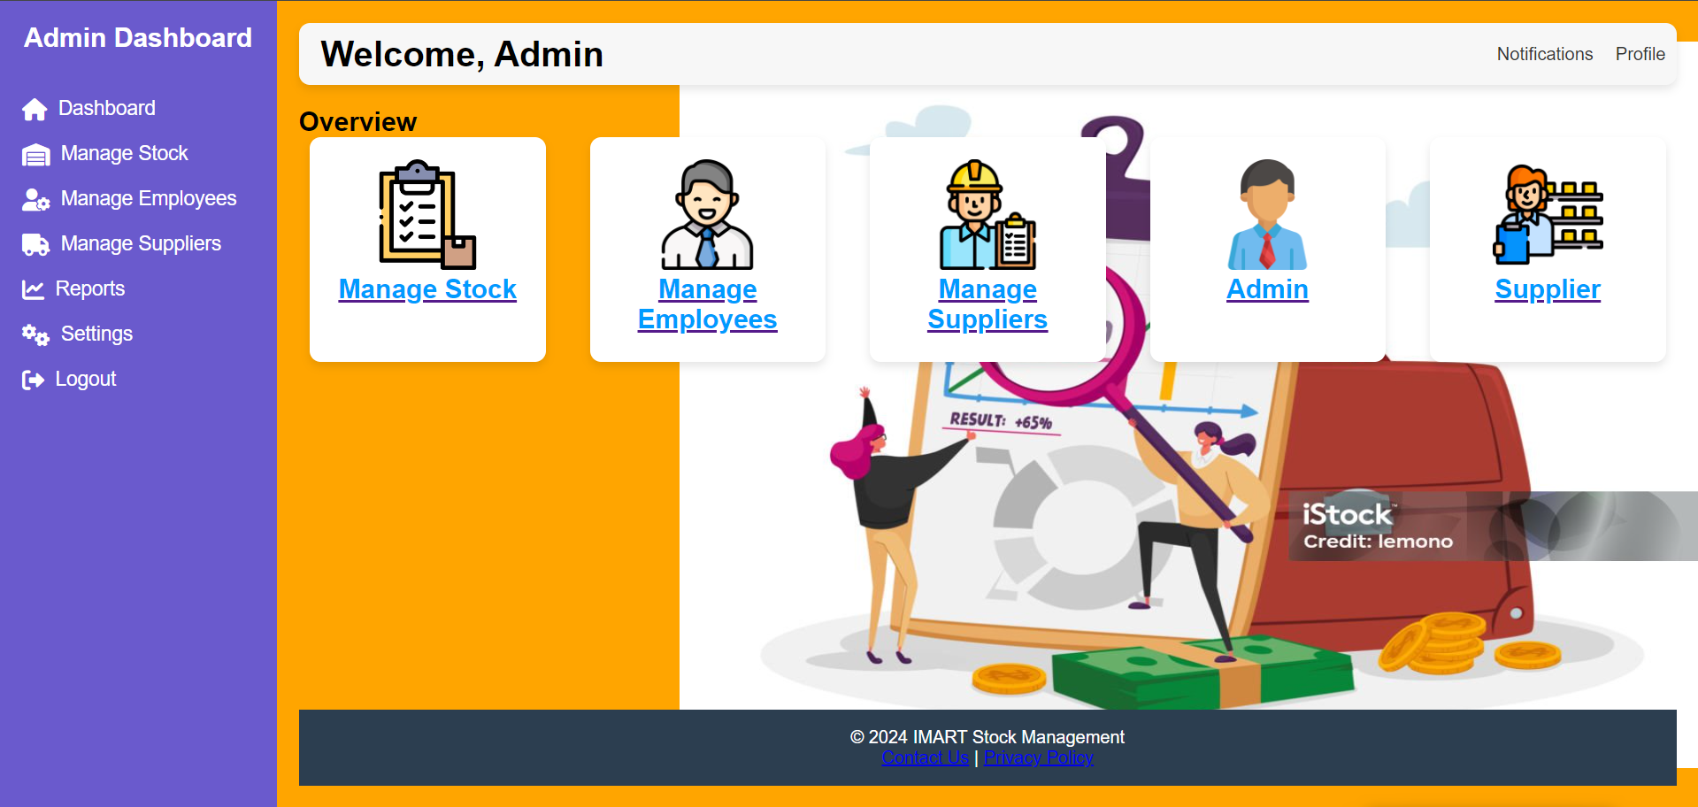
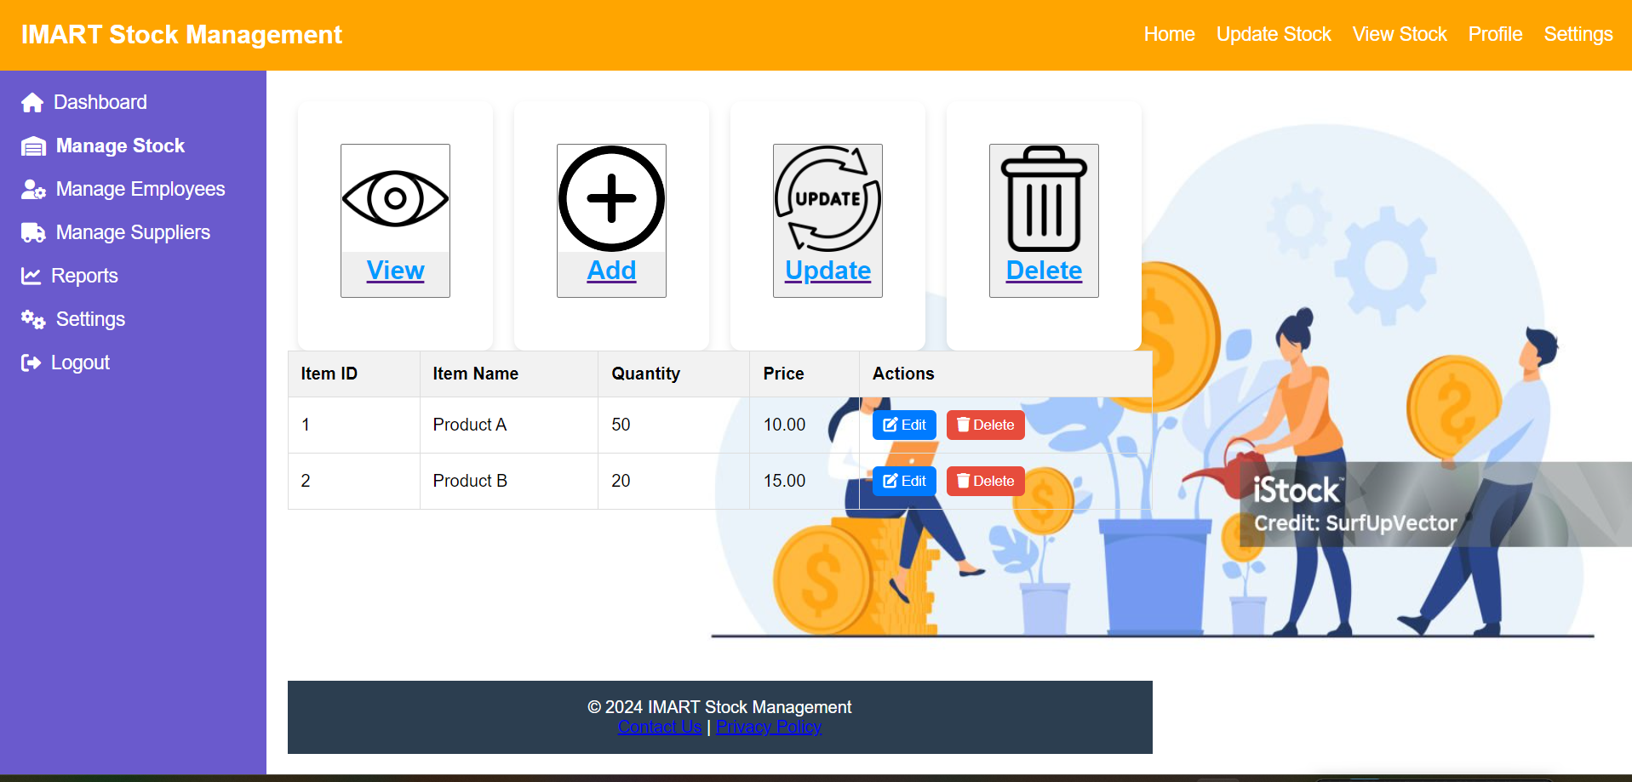
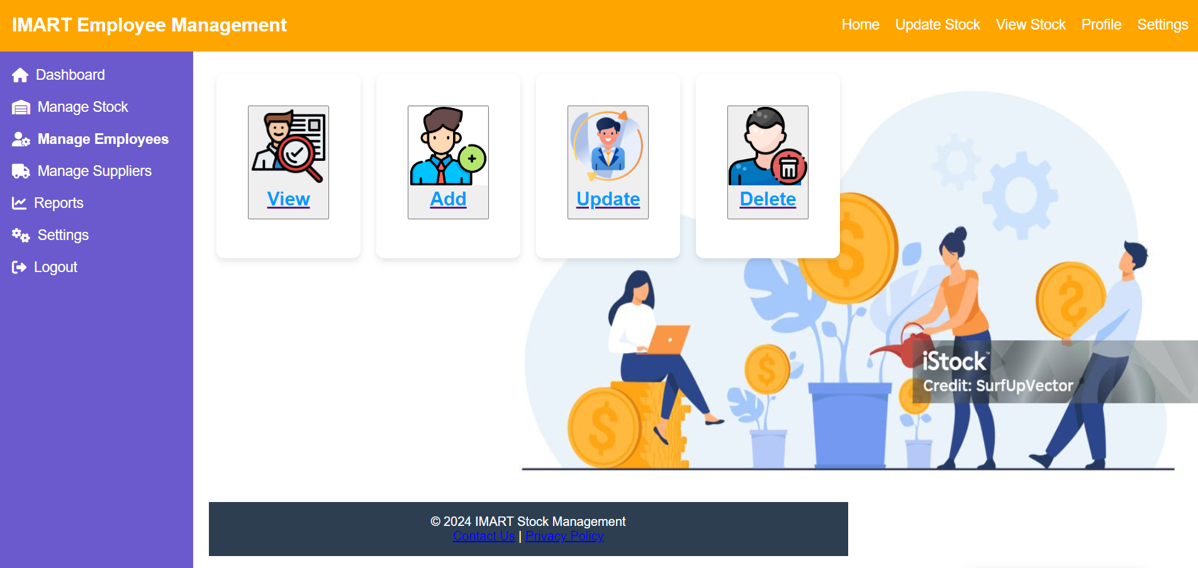
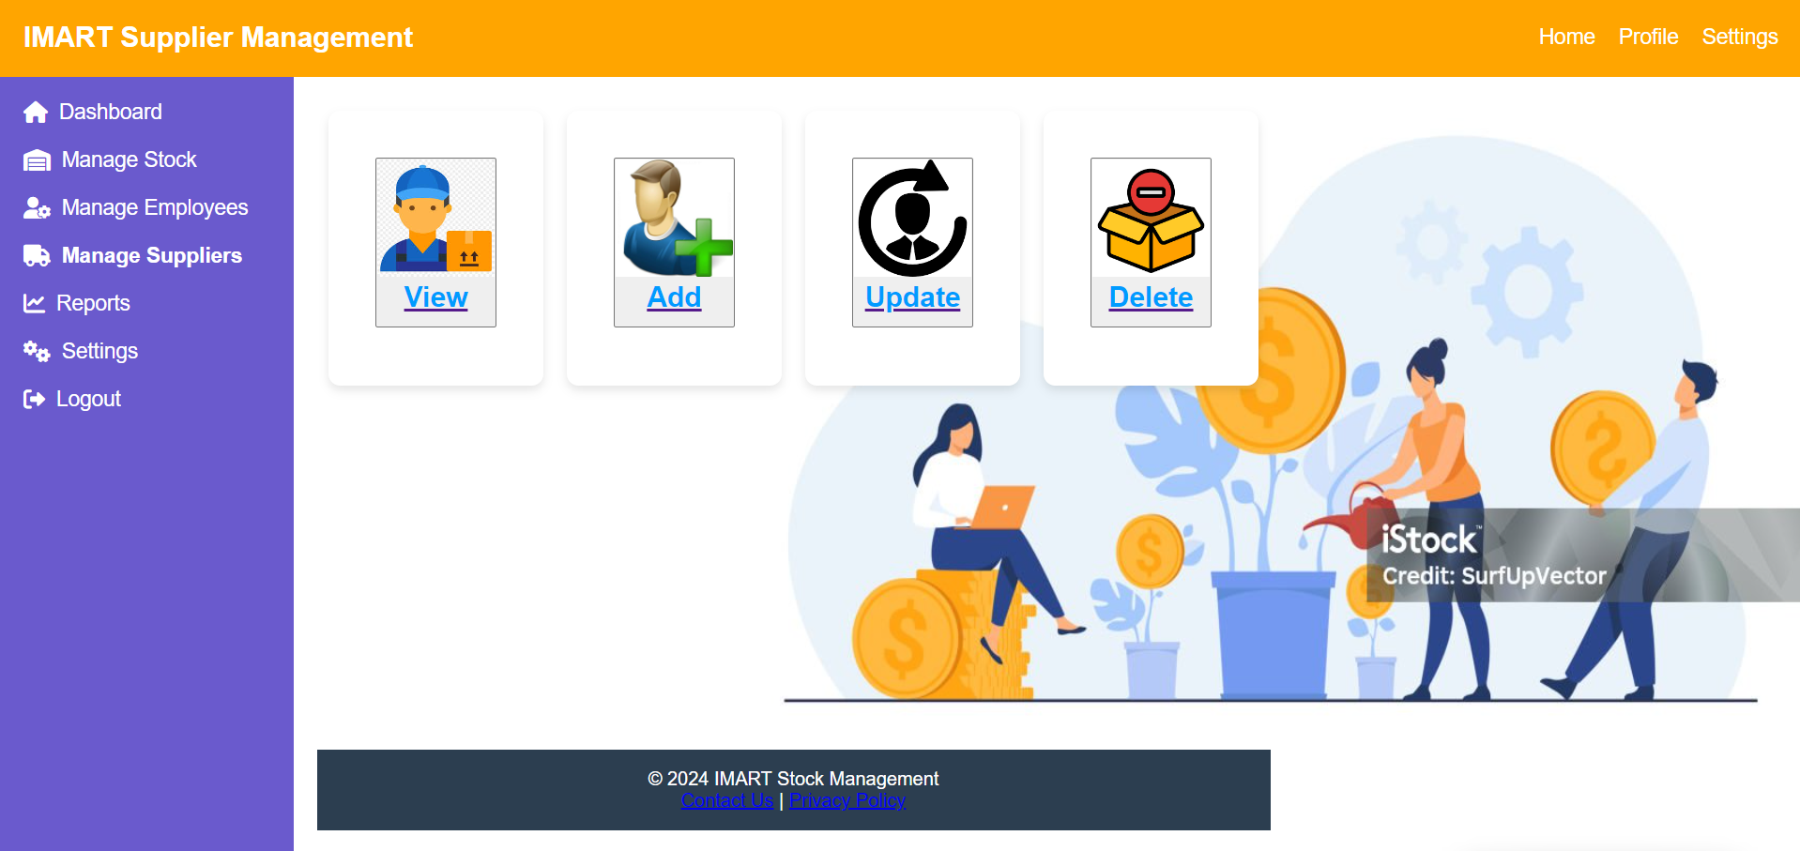
User Interfaces
Admin Dashboard
Stock Manage Dashboard
Employee Dashboard
Supplier Dashboard

